Slide 1
AI-BASED SMART TRAFFIC MANAGEMENT SYSTEM
PRESENTED BY :
M.VENKAT SNEHITH

Slide 2
Abstract
*Problem Statement:*
Indian cities suffer from severe traffic congestion, inefficient public transport planning, and lack of real-time traffic monitoring. AI-driven solutions can optimize traffic flow, reduce congestion, and enhance road safety.
*Objective:*
To develop an AI-powered smart traffic management system that dynamically adjusts traffic signals, predicts congestion zones, reroutes vehicles efficiently, and enhances public transport scheduling.
*Key Outcomes & Impact:*
- Reduction in traffic congestion and travel time
- AI-powered traffic violation detection and e-challan system
- Improved efficiency in public transport scheduling
- Data-driven insights for city planners and traffic police
*Target Audience:*
Traffic authorities, urban planners, public transport operators, and commuters.

Slide 3
Proposed Solution
*Overview:*
Our solution leverages AI to analyze real-time traffic data and dynamically optimize traffic flow. It includes:
- *AI-Based Adaptive Traffic Signals*: Adjusts signal timings based on real-time traffic density.
- *Smart Vehicle Rerouting System*: Predicts congestion and suggests alternative routes.
- *Real-Time Traffic Violation Detection*: Uses computer vision to identify rule violations.
- *Public Transport Optimization*: AI-driven scheduling to enhance peak-hour efficiency.
*Unique Selling Points:*
- *Innovation*: Uses real-time AI-based analytics for traffic management.
- *Efficiency*: Reduces travel time and enhances traffic flow.
- *Impact*: Improves road safety and optimizes public transport.

Slide 4
Technology Stack
*Technologies Used:*
- *Machine Learning & AI:* TensorFlow, OpenCV
- *Data Processing:* Python, Pandas
- *Traffic Data Collection:* IoT sensors, CCTV cameras
- *Backend & APIs:* Flask, FastAPI, Google Maps API
- *Frontend & Visualization:* React.js, Dashboard
- *Cloud & Hosting:* AWS/GCP,
*Justification:*
- *AI & Computer Vision*: For real-time traffic analysis.
- *Cloud Computing*: For scalability and real-time updates.
- *APIs*: For routing and real-time traffic data integration.

Slide 5
Implementation & Development Process
*Steps Taken:*
1. Data collection from cameras, sensors, and APIs.
2. Training AI models for congestion prediction and violation detection.
3. Developing an adaptive traffic signal control system.
4. Implementing vehicle rerouting algorithms.
5. Creating an AI-driven scheduler for public transport.
6. Building a dashboard for monitoring and analysis.
*Key Features:*
- Real-time traffic signal adjustments.
- AI-based violation detection (e.g., red-light jumping, overspeeding).
- Dynamic vehicle rerouting based on congestion patterns.
- Predictive scheduling for buses and metros.
*Challenges & Solutions:*
- *Data Availability*: Overcame by using public APIs and synthetic data generation.
- *Processing Speed*: Optimized models for real-time inference.
- *Integration with Existing Systems*: Used modular API-based approach.

Slide 6
Testing & Results
*Testing Strategies:*
- *Manual Testing:* Field validation with live traffic data.
- *Automated Testing:* AI model accuracy validation.
- *Performance Testing:* Latency checks on real-time updates.
*Results:*
- *Adaptive Signals*: Reduced wait time by 30%.
- *Violation Detection*: 95% accuracy in identifying traffic violations.
- *Public Transport Optimization*: Increased scheduling efficiency by 20%.

Slide 7
Deployment
*Hosting & Deployment:*
- *Cloud-based Deployment*: AWS/GCP for scalability.
- *Edge Computing*: Processing traffic data locally for real-time decisions.
- *Live Demo Link*: [live feed]

Slide 8
Future Enhancements
- It is applicable four wheelers and more then four wheelers who ever not follow traffic rules like not wearing seat belts.
- It is also used in detect who ever park there vechiles in no parking area.
- *AI-Powered Pedestrian Safety System*
- *Enhanced Public Transport Demand Prediction*

Slide 9
Conclusion
This project showcases how AI can be leveraged for efficient urban traffic management. Through adaptive traffic signals, smart rerouting, and automated violation detection, our solution improves mobility and road safety.

Slide 10
References
-Google Maps API Documentation
- TensorFlow & OpenCV Documentation
- Research papers on AI in Traffic Management

Slide 11
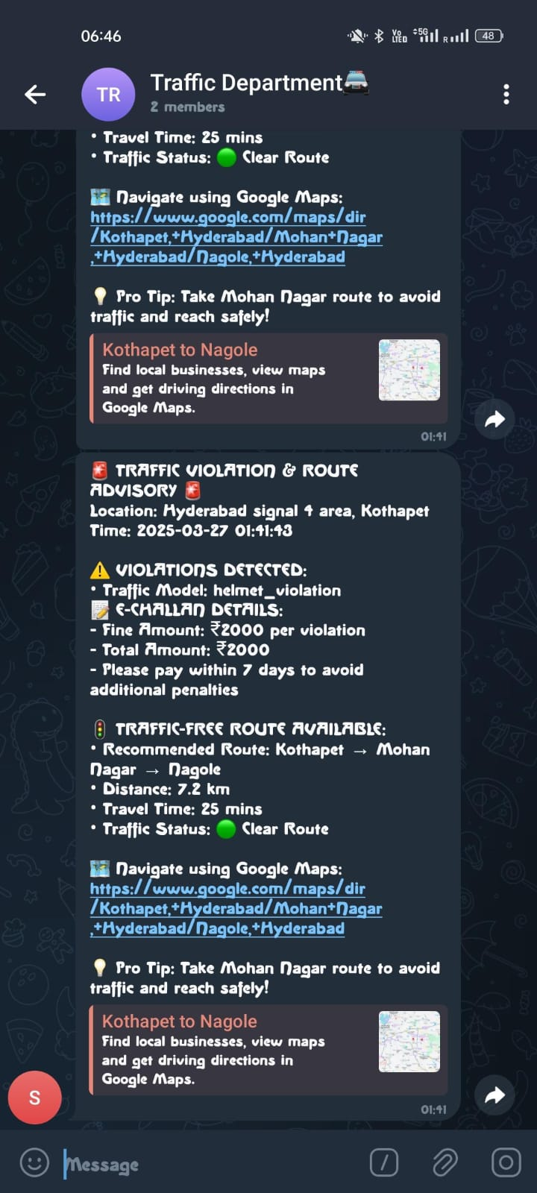
output

Slide 12
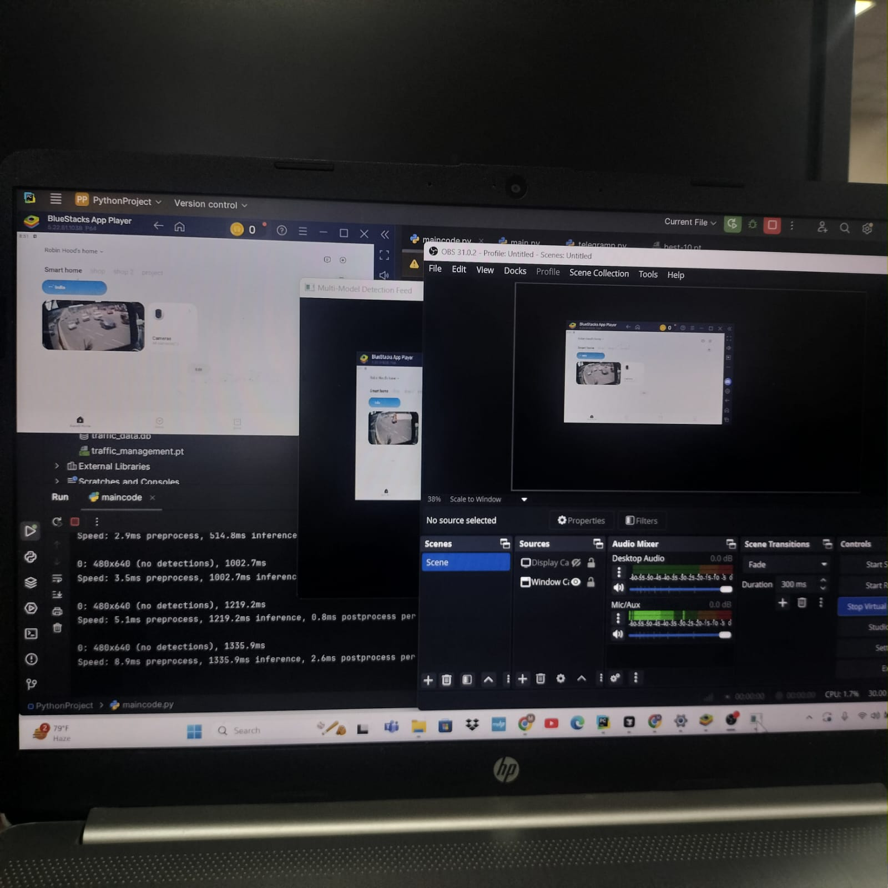
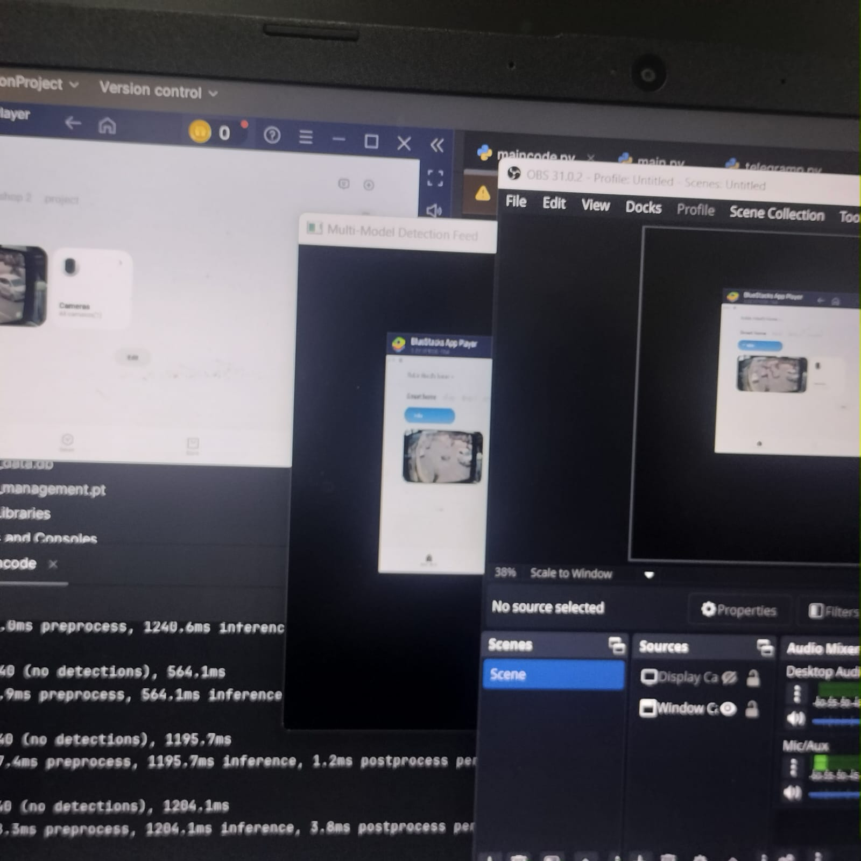

OUTCOME AND SOURCE
OUTCOMES OUTCOME SOURCE

